Slide 1
Sales Analysis_V1
File created on: 8/21/2023 10:21:42 AM

Slide 2


Slide 3


Slide 4
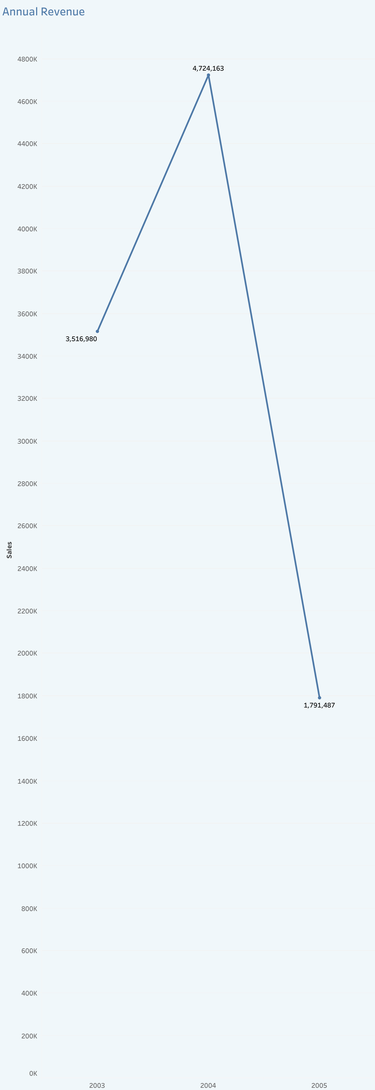

Slide 5


Slide 6
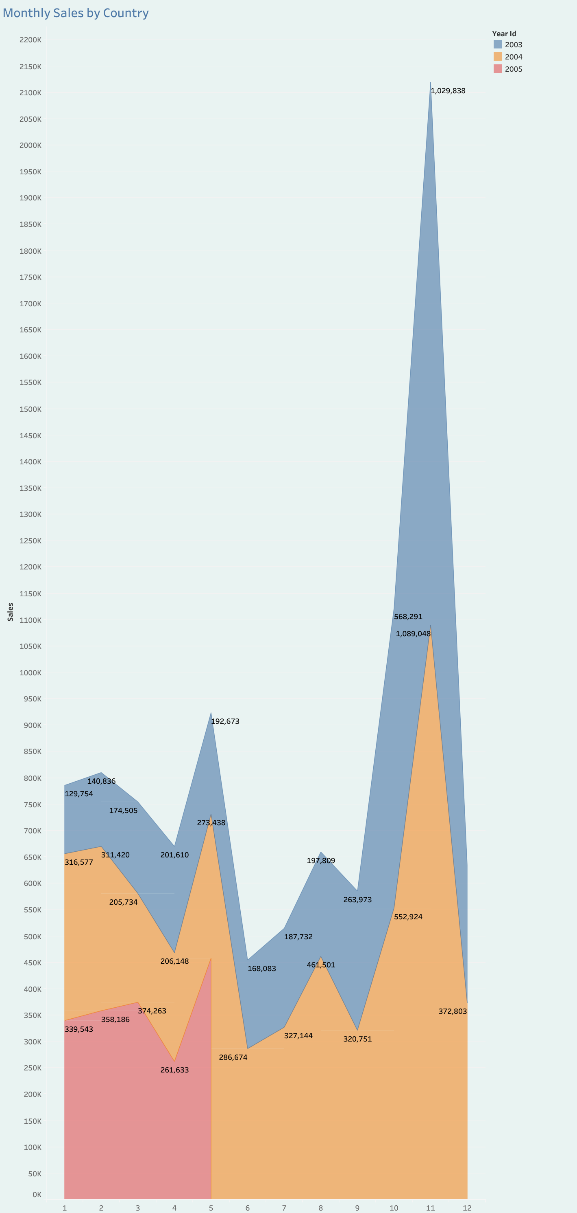

Slide 7
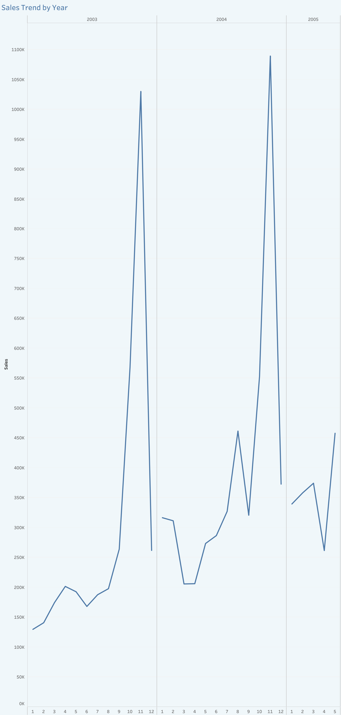

Slide 8
